Slide 1
JUVENILE JUSTICE IN NORTH CAROLINA
Valerie Pearce, J.D.
Indigent Defense Services

Slide 2
PURPOSE OF JUVENILE COURT
To reduce and prevent juvenile delinquency by effectively intervening, educating and treating youth in order to strengthen families and increase public safety. (per DPS-JJ 2016 Annual Report)
NCGS 7B-1500. Purpose (1)To protect the public from acts of delinquency.(2)To deter delinquency and crime, including patterns of repeat offending: a. By providing swift, effective dispositions that emphasize the juvenile offender's accountability for the juvenile's actions; and b. By providing appropriate rehabilitative services to juveniles and their families.(3)To provide an effective system of intake services for the screening and evaluation of complaints and, in appropriate cases, where court intervention is not necessary to ensure public safety, to refer juveniles to community-based resources.(4)To provide uniform procedures that assure fairness and equity; that protect the constitutional rights of juveniles, parents, and victims; and that encourage the court and others involved with juvenile offenders to proceed with all possible speed in making and implementing determinations required by this Subchapter.

Slide 3
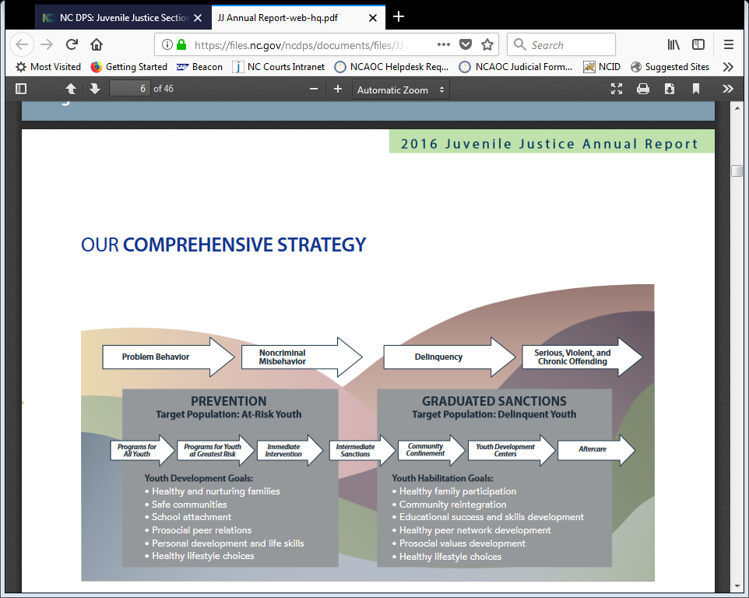

Slide 4
WHAT IS DIFFERENCE BETWEEN JUVENILE AND ADULT CRIMINAL?
1868-First juvenile court created in North Carolina
1967-IN RE GAULT, 387 US 1 (1967). the Supreme Court affirmed due process rights for juveniles by providing the rights to counsel, notice of charges, the right to confrontation and cross examination, the privilege against self-incrimination, and the right to appellate review. The dissenting voice, Justice Potter Stewart, expressed concern that the court's decision would "convert a juvenile proceeding into a criminal prosecution." He held to the historical intent of the juvenile justice system, which was not to prosecute and punish young offenders, but to "correct a condition," and meet society's "responsibilities to the child."

Slide 5
Difference between Juvenile Delinquency and Juvenile Abuse/Neglect/Dependency
NCGS 7B-900. The purpose of dispositions in juvenile actions is to design an appropriate plan to meet the needs of the juvenile and to achieve the objectives of the State in exercising jurisdiction. If possible, the initial approach should involve working with the juvenile and the juvenile's family in their own home so that the appropriate community resources may be involved in care, supervision, and treatment according to the needs of the juvenile. Thus, the court should arrange for appropriate community-level services to be provided to the juvenile and the juvenile's family in order to strengthen the home situation.
Right to Guardian ad Litem once a petition has been filed alleging abuse, neglect, or dependency of the juvenile by the parent/guardian.

Slide 6
Role of Defense Counsel and Other Stakeholders in Juvenile Court
Juvenile Defense Attorney represents the express interest of the juvenile client, with the same attorney-client privilege and rights of confidentiality as an adult criminal defendant.
The Court Counselor is like a probation officer and makes recommendations as to the best interests of the child and the safety of the community.
The judge follows the laws of North Carolina and the State and US Constitutions, is an objective fact-finder, and makes dispositional orders that are in the best interest of the juvenile after making a determination that a crime or status offense have been proven beyond a reasonable doubt by the prosecutor.
The juvenile court also has jurisdiction over parents and can make orders of the court which include the parent in the juvenile’s disposition.

Slide 7
RIGHTS?
NO RIGHT TO BOND/NO RIGHT TO JURY TRIAL
RIGHT TO COUNSEL
RIGHT TO DISCOVERY
RIGHT TO NOTICE
RIGHT TO PROBABLE CAUSE HEARING
RIGHT TO HEARING ON RESTRAINTS
INTERROGATION RIGHTS TO PARENT/ATTORNEY

Slide 8
STRUCTURE OF JUVENILE SYSTEM
Complaints to Intake at Department of Juvenile Justice by law enforcement, schools, private citizens.
CHOICES:
  CLOSURE
  DIVERSION
  FILE A PETITION and send to juvenile court

Slide 9
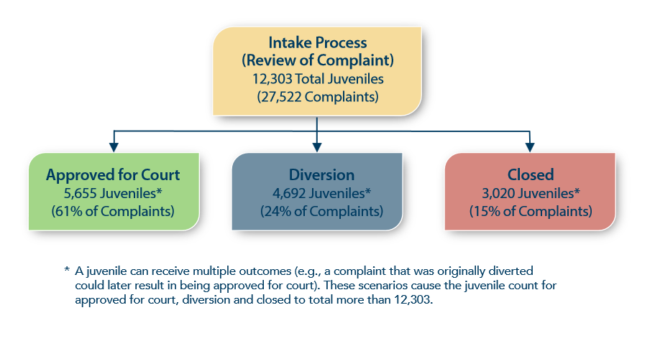

Slide 10
JUVENILE JURISDICTION IN NORTH CAROLINA
“RAISING THE AGE” legislation
Last state to automatically treat 16 year old and older offenders automatically as adults in criminal justice system.
As of July 2017 and effective December 1, 2019, all juveniles under the age of 18 who commit alleged crimes, except traffic offenses, will begin in juvenile court. A through E felonies will be automatically transferred to adult court upon a finding of probable cause or indicted by a grand jury to Superior Court.

Slide 11
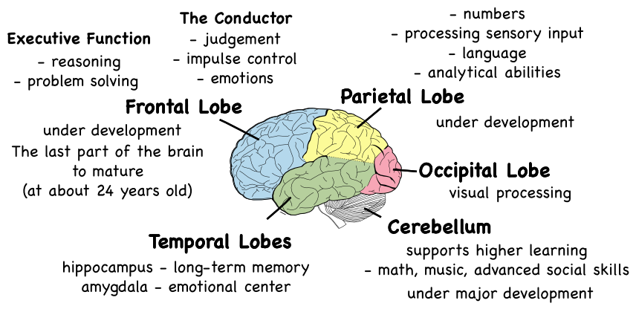
RESEARCH GUIDING STRATEGIC REFORMS
BRAIN DEVELOPMENT research shows that the frontal cortex section of the brain, which helps with impulse control, is one of the last parts to develop. Research shows the brain is fully developed in males by age 25, or around age 22-23 for females.

Slide 12
TRENDS IN COMPLAINTS AND PETITIONS
63% of juvenile offense complaints in NC in 2016 were minor offenses (misdemeanors); 3% were violent(A-E felonies); 25% were serious felonies (F-I felonies); 8% status offenses(undisciplined/truancy), and 1% were infractions(traffic offenses).
Trending lower number of complaints from 2010 to present. (Gone down from 37,343 in 2010 to 27,522 in 2016.)
The number of juveniles placed in detention has reduced by 56%.
The number of juveniles committed to youth development center has reduced by 48%.

Slide 13
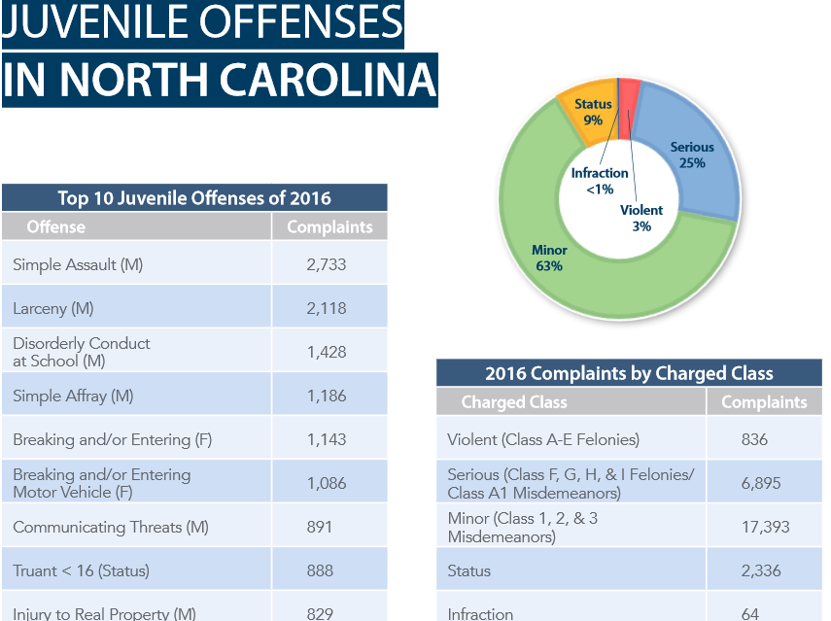

Slide 14
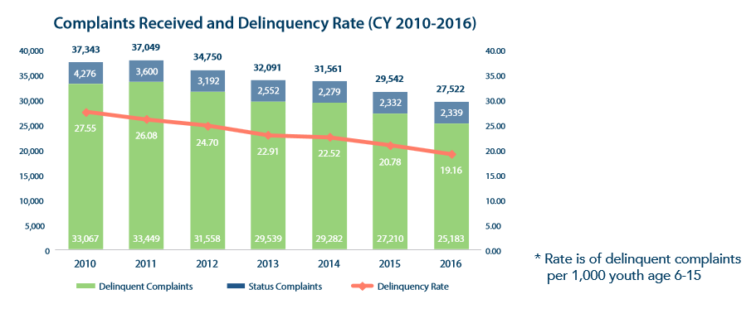

Slide 15
DETENTION AND YOUTH DEVELOPMENT CENTERS
DETENTION=generally shorter term=equivalent of jail for adults
YOUTH DEVELOPMENT CENTER=long term=movement to use mostly for serious offenders or chronic, repeat offenders=equivalent of prison for adults.
More programmatic-includes education, health services, mental health treatment and substance abuse treatment, and reentry services.

Slide 16
SCHOOL TO PRISON PIPELINE: Reducing number of school-based complaints
Since 2010, the number of school-based complaints have dropped from 16,097 to 11,630 in 2016 (a nearly 28 percent decrease).
While the number of school-based complaints has dropped, the percentage of the total amount of complaints received has remained steady at around the mid-40 percentages.
Zero tolerance policies in NC cause students to miss school due to suspensions and expulsions, in addition to facing charges in juvenile court and potentially being placed on probation for the same incidents. Research shows that this significantly increases the rate of recidivism into both the juvenile and adult systems.

Slide 17
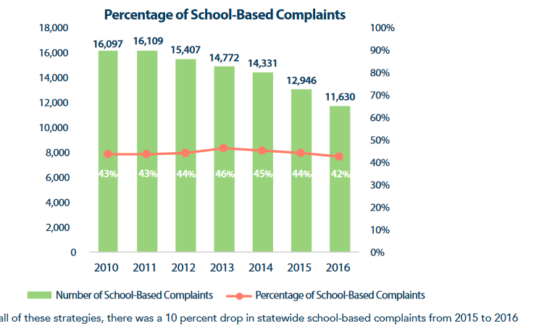

Slide 18
DJJ now DPS-JJD: INCREASED DIVERSIONS
During calendar year 2016, 27,522 complaints were received involving 12,303 juveniles (some juveniles received multiple complaints). Of the 12,303 juveniles who participated in the intake process, 5,655 had one or more complaints approved for court; 4,692 were diverted from court with or without diversion plans/contracts; and 3,020 had complaints that were closed.
Research has demonstrated that when appropriately implemented, diversion reduces recidivism, reduces costs to the state/communities, avoids the unintended negative consequences of being labeled a delinquent, allows for the provision of needed services, and prevents unnecessary confinement. By intervening early, most young people who are diverted have no further contact with the justice system.

Slide 19
DISPROPORTIONATE MINORITY CONTACT
Minority youth are engaged with the juvenile justice systems at a much higher rate than their proportion of the general population.
This overrepresentation is evident in three distinct points in the system.
  INTAKE:Youth of color are more than two and a half times as likely to have complaints filed against them by law enforcement or other citizens than white youth.
  INCARCERATION: The second and third points are around the decisions leading to secure detention and commitment to a youth development center (YDC).

Slide 20
JUVENILE GANG INVOLVEMENT
The number of gang-affiliated juveniles in our system has consistently dropped over the last seven years . Due to efforts to divert lower-risk juveniles, the overall percentage of the youth we serve who are gang-affiliated has increased by half of a percent since 2015.
Since 2010, the number of gang-affiliated youth has decreased by 37 percent (from 1,842 to 1,183).

Slide 21
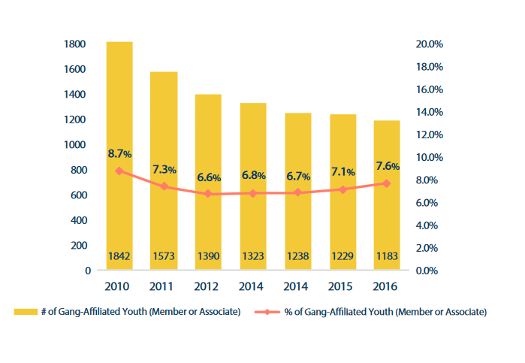

Slide 22
FAMILY INVOLVEMENT
The likelihood that a juvenile will be successful decreases with a lack of family involvement.
The likelihood that a juvenile will recidivate increases, even with the best quality services, if the juvenile returns to the same environment that brought him or her into the system when they complete the programs.
It is critical that parents and family members participate in programming with the juvenile and take responsibility for their role in the circumstances leading to juvenile involvement.

Slide 23
MOTIVATIONAL INTERVIEWING
Juvenile Justice professionals have been trained in motivational interviewing and observation techniques in order to encourage and increase in family and juvenile involvement.
Motivational interviewing is a psychotherapeutic approach that attempts to move an individual away from a state of indecision or uncertainty and towards finding motivation to making positive decisions and accomplishing established goals.
This psychological theory and form of therapy was created by Carl Rogers in the 1950s and 1960s as an alternative to psychoanalytic and behaviorist views. Person-centered thought is based on the idea that people have innate goodness and value in them. It is the work of the counselor to permit the clients to create the best version of themselves.

Slide 24
RISK ASSESSMENTS
In North Carolina, the majority of juvenile justice districts are using the Global Assessment of Individualized Needs – Short Screener (GAIN-SS), which has been integrated into North Carolina Juvenile Online Information Network (NC-JOIN), the web-based system used by juvenile justice staff to track the progress and placement of youth being served by various programs and facilities.
In North Carolina, GAIN-SS screenings indicated that 73 percent of youth were in need of further assessment for mental health and/or substance use (based on scoring high on the total disorder).

Slide 25
Juvenile Crime Prevention Councils: Resources for More Community Programs
JCPC Programs are funded through a state and local partnership in all 100 counties. These partnerships between the state, local county stakeholders and nonprofit agencies produce more than 500 programs that establish a local continuum of needed sanctions and services to address the issues of delinquent juveniles and those youths most likely to become delinquent, along with their families. JCPCs are legislatively mandated bodies that annually release requests for proposals to inform funding decisions based on community demographics, risks, needs and gaps in services.

Slide 26
Mental Health Reforms in North Carolina
For more than 15 years, the mental health system in North Carolina has undergone multiple overhauls. We have moved from county mental health clinics that provided all of the mental health and substance abuse care to a private-provider system managed by regional Managed Care Organizations. Future Medicaid reform will likely create additional upheaval of services provided.
MCO’s take bids from local providers to provide services identified as needed. Not all counties have a wide continuum of care to meet the needs of citizens locally.
Youth with multiple issues struggle to find care to meet all of their needs. (Example: “WILLIE M Youth” and Disability Rights NC settlement)

Slide 27
Treatment Levels
Treatment is based on graduated levels of care.
A representative point-in-time survey of youth confined in youth development centers on Dec. 31, 2016, revealed that:
99.5 percent (all but one) carried at least one mental health diagnosis,with 61 percent holding at least one substance use diagnosis;60 percent had co-occurring mental health and substance use disorders; 70 percent had more than one mental health disorder; 33 percent were taking prescribed psychotropic medication; and youth committed to YDCs had an average of three distinct mental health and/or substance use disorder diagnoses.

Slide 28
Psychiatric Residential Treatment Facilities
A Psychiatric Residential Treatment Facility (PRTF) provides non-acute inpatient facility care for customers with a mental illness or substance abuse/dependency, and who need 24-hour supervision and specialized interventions in a locked door setting.
Example of The Keys of Carolina PRTF in Charlotte, N.C.

Slide 29
Trauma-Focused Treatment Modalities
Each year, millions of children are exposed to violence in their homes, schools, and communities. Left unaddressed, these experiences can lead to mental health and substance use disorders, school failure, increased risk taking, and delinquency.
The majority of youth involved with the juvenile justice system have experienced traumatic events, with at least 75 percent having experienced traumatic victimization (Sprague, 208). A recent study of youth in detention found that over 90 percent of youth had experienced at least one trauma, 84 percent experienced more than one trauma, and over 55 percent reported being exposed to trauma six or more times.

Slide 30
Measuring Program Effectiveness
North Carolina is one of more than 10 states that have embraced the Standardized Program Evaluation Protocol (SPEP) as an evaluation tool to identify the most effective services with the highest potential to reduce juvenile recidivism. North Carolina General Statutes require that Juvenile Crime Prevention Councils (JCPCs) fund only effective programs and SPEP is the state’s response to complying with this mandate. It allows for an examination of how a specific program is performing compared to the effective practice for that service type in the research. This research-based process is being instituted to push programs to model best practices for their program type to have the greatest impact on the reduction of recidivism.

Slide 31
Alternatives to Incarceration
Alternatives to detention and confinement are approaches taken to prevent juveniles from being placed in either secure detention or confinement facilities when other treatment options, community-based sanctions, or residential placements are more appropriate.
Such alternatives were developed in response to research indicating that detention and confinement may do more harm than good for vulnerable juveniles (Austin, Johnson, and Weitzer 2005).
“alternatives to secure detention and confinement are intended to reduce crowding, cut the costs of operating juvenile detention centers, shield offenders from the stigma of institutionalization, help offenders avoid associating with youths who have more serious delinquent histories, and maintain positive ties between the juvenile and his or her family and community.”

Slide 32
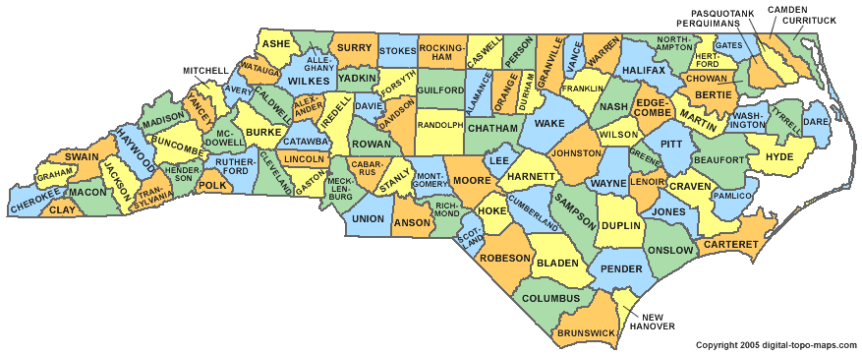
Resources Dependent on Community

Slide 33
Juvenile ReEntry Reform/Collateral Consequences
North Carolina was one of three states to be awarded a FY 2015 Second Chance Act Comprehensive Statewide Juvenile Reentry Reform Implementation Program grant. With a total program budget of $1.47 million, the implementation grant is working to accomplish four primary objectives tied to service planning and service matching, family engagement, education and workforce development, and the evaluation of the program efforts.
Additional efforts are being made to make expungement procedures more readily available.

Slide 34
Juvenile Health Services
Provide preventive and acute health care to juveniles in residential centers. Care involve admission baseline health assessments and physicals as well as preventive health care, response to illness, care management and age-appropriate health education.
Most juvenile justice involved youth do not have continuity of care or communication or records from one provider to the next.

Slide 35
Educational Services
Students who are identified as exceptional (i.e., having a disability) should receive an Individual Education Plan (IEP) developed according to the federal Individuals with Disabilities Education Act (IDEA) guidelines.
School personnel may remove a child with a disability who violates a code of student conduct for a period of 10 SCHOOL DAYS OR LESS and the child may be treated the SAME as children without a disability.
ADDITIONAL PROTECTIONS APPLY TO A CHILD WITH AN IEP WHO HAS BEEN REMOVED FOR MORE THAN 10 SCHOOL DAYSWITHIN A SCHOOL YEAR. A Manifestation Determination Review may be held to determine if the behavior falls within the disability and requires a modification of the IEP.

Slide 36
Transfers to Adult Court System
North Carolina's discretionary judicial waiver statute allows juvenile court judges to transfer into adult court young people as young as 13 accused of felonies.
Youth as young as 13 may face mandatory waiver to adult court for Class A (First Degree Murder) felonies (statutory exclusion) upon a finding of probable cause. (This remains after Raise the Age provision.)
After a youth is transferred to and convicted in superior court, he or she must be prosecuted as an adult for any charge thereafter, no matter how minor the subsequent offense.

Slide 37
DISCUSSION AND QUESTIONS

